Slide 1

Aquasensor 2

Slide 2
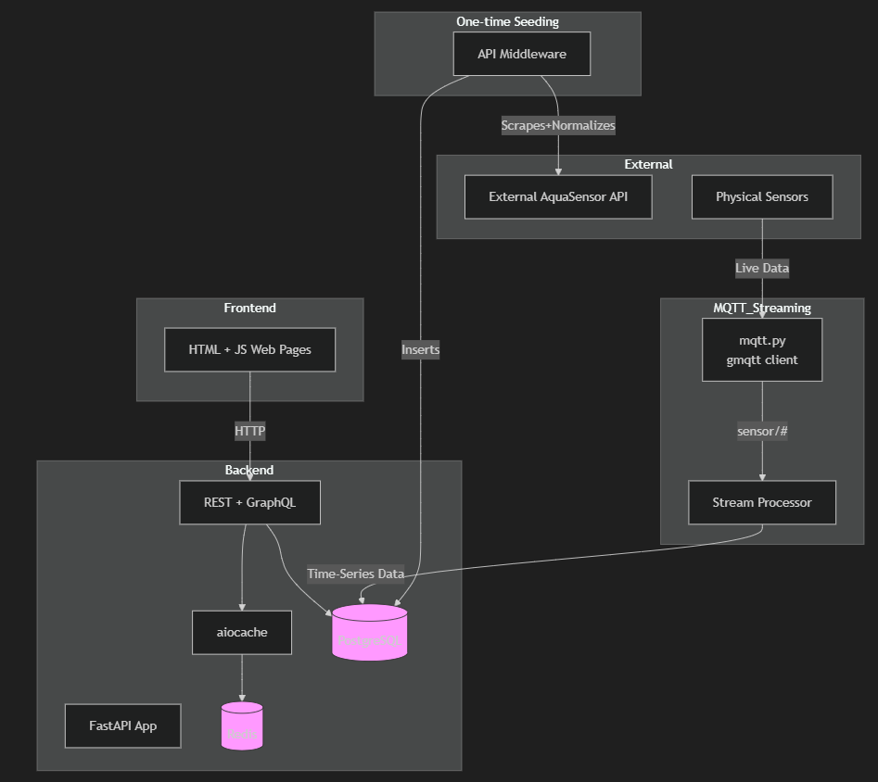
Tech stack and why we chose it. -MQTT: Required from Aquasensor -Streamer processor: We have MQTT data and need to move it to POSTGRES and so it was required. We picked python as the data velocity was still rather slow. -POSTGRES: Because it has extensions for geospatial data, open source and very cheap to deploy and maintain. Is Scalable. -Redis: Cache upstream responses, needed external KV store to allow backend to remain stateless. -Front end: Went with vanilla HTML and CSS and we templated that with ginger since it has native support with our backend technologies. -Backend: Fast API as it allows for persistent session data. Provides auto-documentation. Extensive industry backed validation system through pydantic -Docker: We chose this as it gives us a standardised environment between production and development. -UV: Dependency management because its lock file allows for reproducible builds.
Team Roles: Finn – Back-end development and Feature Development Jake – Back-end integrator and Studio editor Connor – Front end development Charlie – Project Documentation, Testing, Odd-Jobs, Compliance checking
ARCHITECTURE DRAWINGS GO HERE

Slide 3
What we would like to have done
If given more time we would have liked to implement a system to give warning when river data suddenly spiked in one direction or another as it could have indicated something wrong with the river. We also would have perhaps gone for a more interesting and robust tech stack however given the time and scope of the task we went for a more streamlined approach to our tech stack. Finally, we would have liked to have implemented a notification system alongside the warnings system to fully realise the websites mobile capabilities.

Slide 4
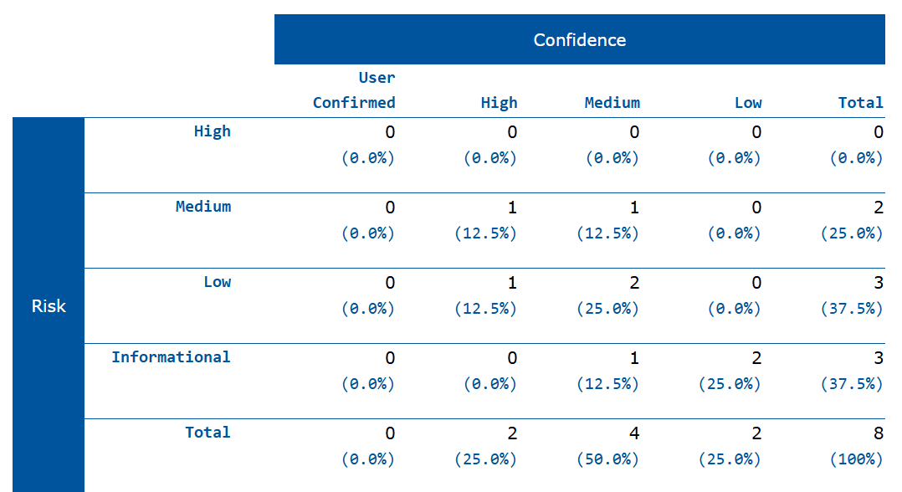
ZAP Report

Slide 5
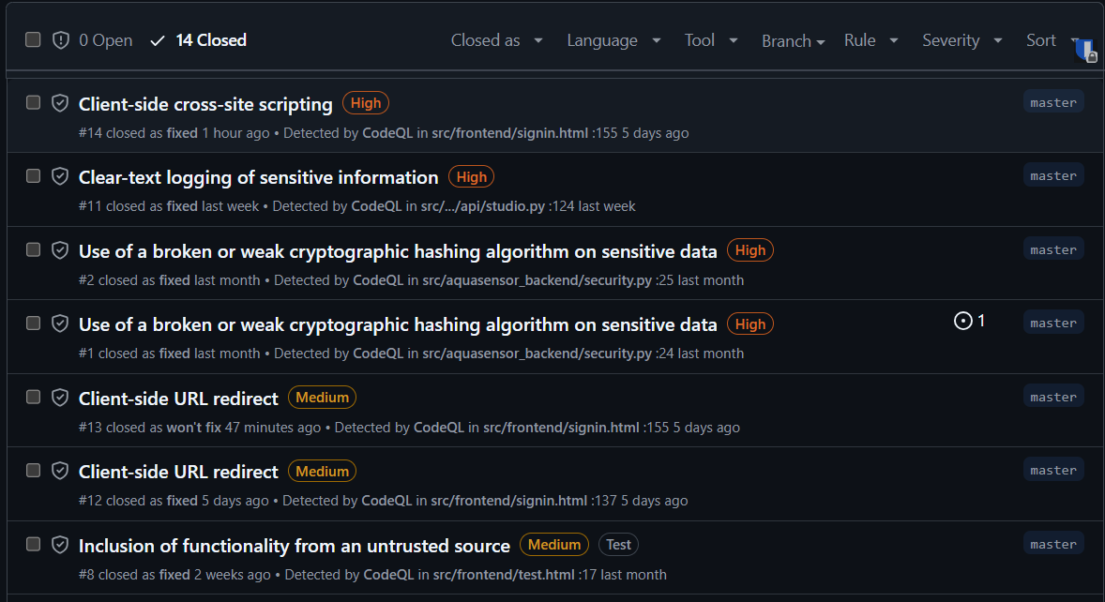
Github Code QL

